Slide 1
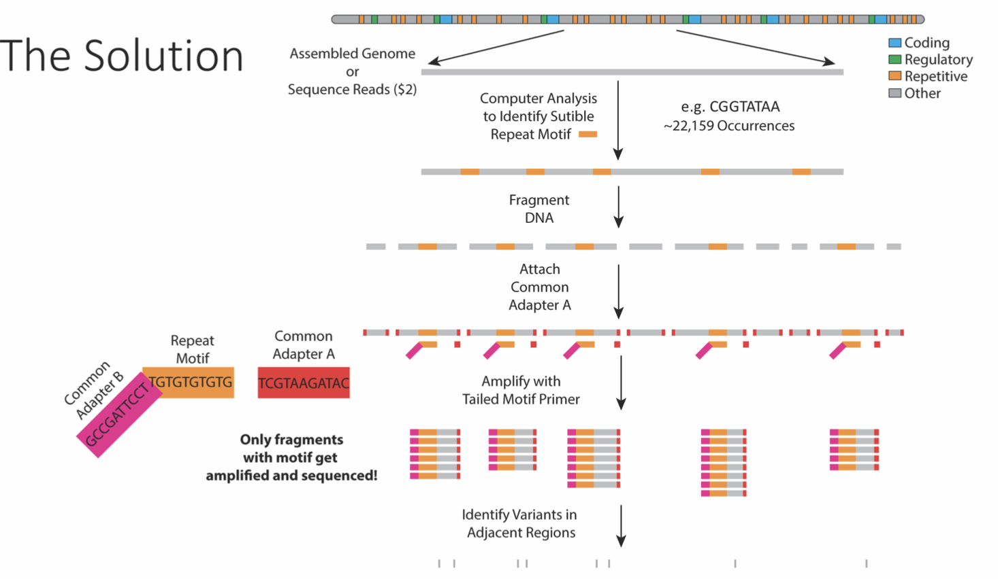
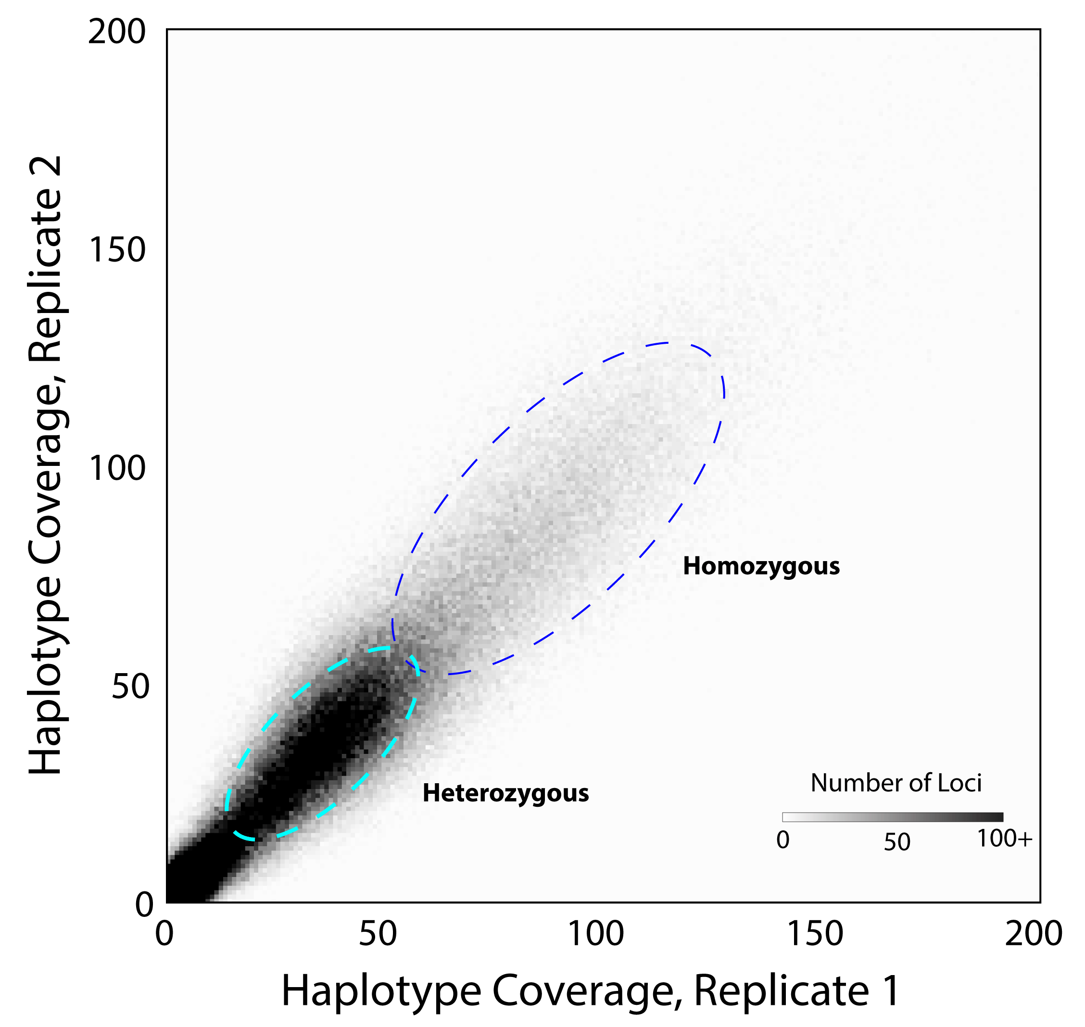
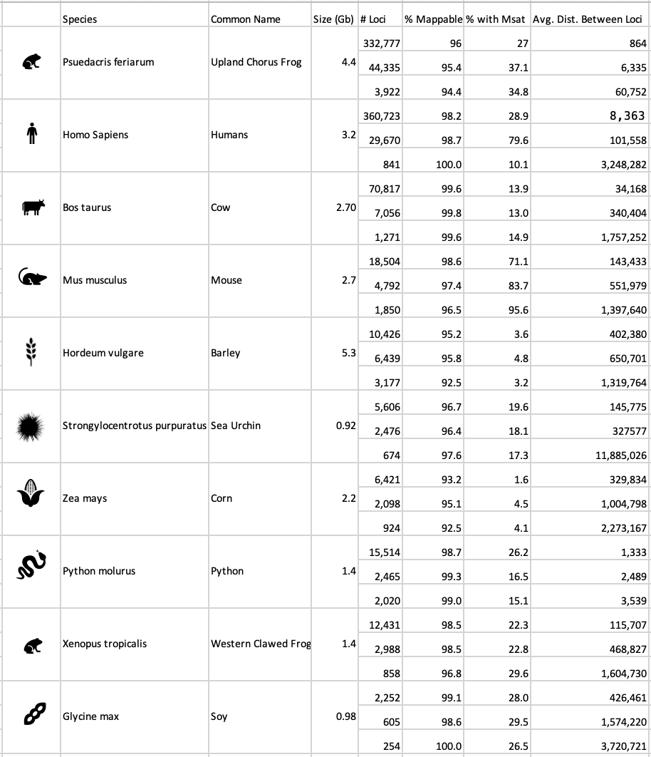
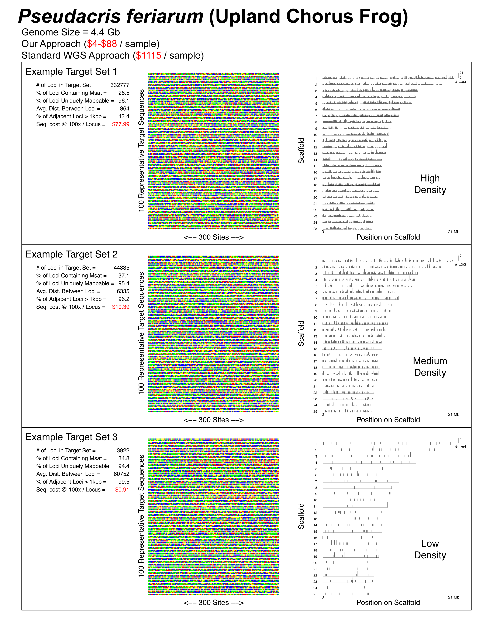
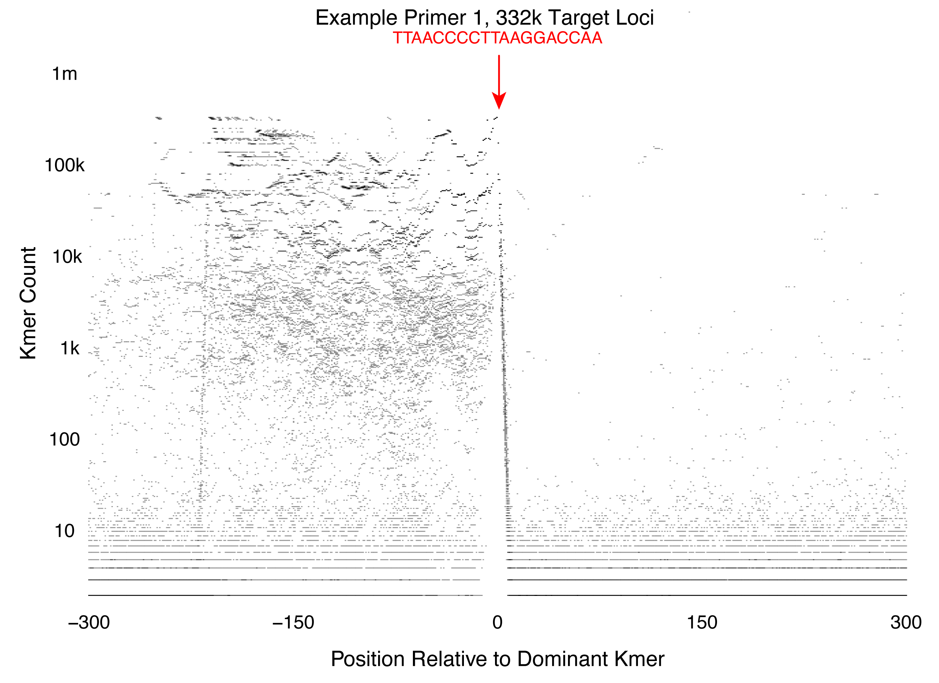
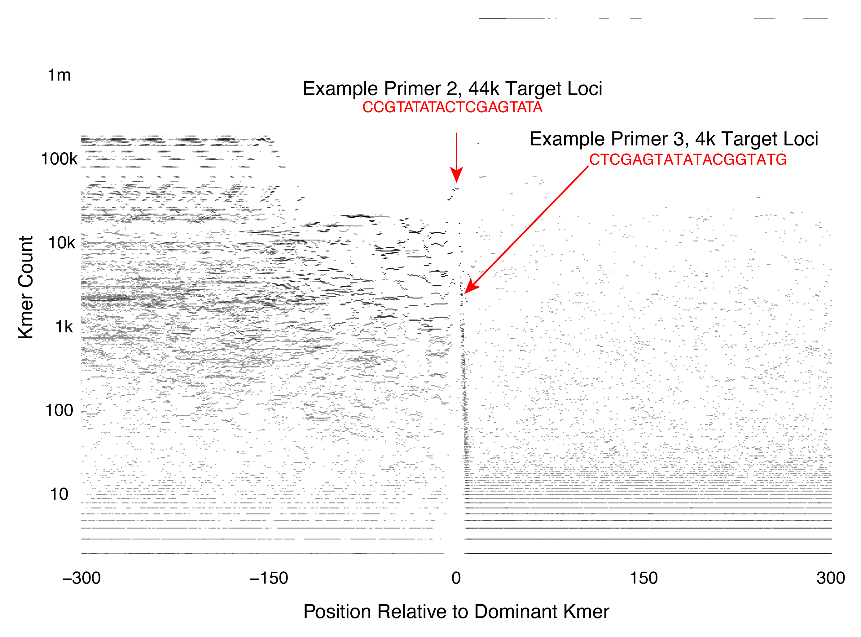
Evaluating a New Method of Obtaining Genotype Data
Katy Merritt and Dr. Alan Lemmon
Abstract
In a patent-pending method, polymerase chain reaction (PCR) is possible using only one primer. The method uses two common adapter sequences and a primer designed to match a repetitive element from a genome. A particular primer can be designed to target a particular number of loci. The focus of this study was to apply a computer program to several example genomes to isolate the best candidate primers. The candidate primers had to meet several requirements including an appropriate melting temperature, length, mapability of flanking regions, and expected number of loci. A maximum of 20 candidate primers were selected for each genome. Some of the primers have been tested, but future work is needed to demonstrate that the selected primers return the expected loci. If the experimental values verify that the primer selection method works as expected, then the method could be used to obtain very inexpensive and customizable genotypes for many applications, including population genetics, forensics, paternity testing, agriculture, and animal breeding.
Introduction
Discussion
The program used to locate these primers takes a fast file and scans 1% of the file to quickly get an idea of the prevalent kmers (19-bp DNA sequence). Once the program has identified possible kmers, it goes through and eliminates kmers that appeared too few times or had too many tandem repeats. Once the initial candidates have been determined, they are sorted into clusters to account for kmers that are identical except for one or two base pairs. Finally, the dominant kmer for each cluster is printed. The kmer sequence is used to develop a primer for PCR.
Our analysis indicates that this new approach has high potential for generating genotype data in many application areas. As indicated by Figures 3-5, a small change in the primer sequences can be used to isolate different sets of loci with different properties. The example primer shown in Figure 3 is expected to yield ~332k loci, whereas primers selected from a different repeat sequence is expected to yield far fewer loci (~44k, or ~4k). Overall, this method is incredibly versatile due to its ability to be used across species as well as its ability to be modified to retrieve a desired number of loci, as shown in Figure 6. Future work will involve testing the selected primers for each of the genomes to see if the number of loci returned matches the expected number.
Acknowledgements
Figure 1. A method recently developed subsamples genomes with a single primer and two common adapters. The primer is designed to match a sequence of nucleotide bases that is repeated throughout the genome. The current study is based around finding these repetitive sequences that return areas of interest in the genome.
Figure 2. The method is highly repeatable across technical replicates. Each point represents one haplotype obtained. The two clouds of points above result from heterozygous and homozygous loci (coverage of 40 and 80 respectively). The coverage distribution suggests that most loci contain at least one variant at a shallow temporal scale (most loci have two haplotypes).
I would like to thank Dr. Alan Lemmon for all of his help and time the past two semesters. I would also like to thank the UROP program for providing this opportunity.
Results
Figure 4. A graphical representation of a repeat element. Each point on the graph represents one kmer, plotted on the x-axis at its position relative to the most abundant kmer in the repeat, and on the y-axis at its count (number of occurrences in the genome). When a primer is designed to match a kmer positioned at the edge of the repeat element, mappable flanks can be obtained.
Table 1. A summary of the properties of some of the most prevalent kmers in 10 different species. Here we have listed several properties, such as number of loci returned, percent with unique mappable flanking region, percent with microsatellite and average distance between the returned loci.
Figure 5. A second example of a repeat element. In this case, two different primers were used to target different numbers of loci.
Figure 3. Three example target locus sets in chorus frogs that can be targeted using different primers. Properties of each target set are shown to the left. Example sequences are shown in center. Genomic distribution is shown at left. Notice that depending on the particular primer used, different numbers of loci can be enriched using the method, to fit the needs of the project. Each of these target locus sets has different properties. For example, some are highly enriched for microsatellites.

